Slide 1
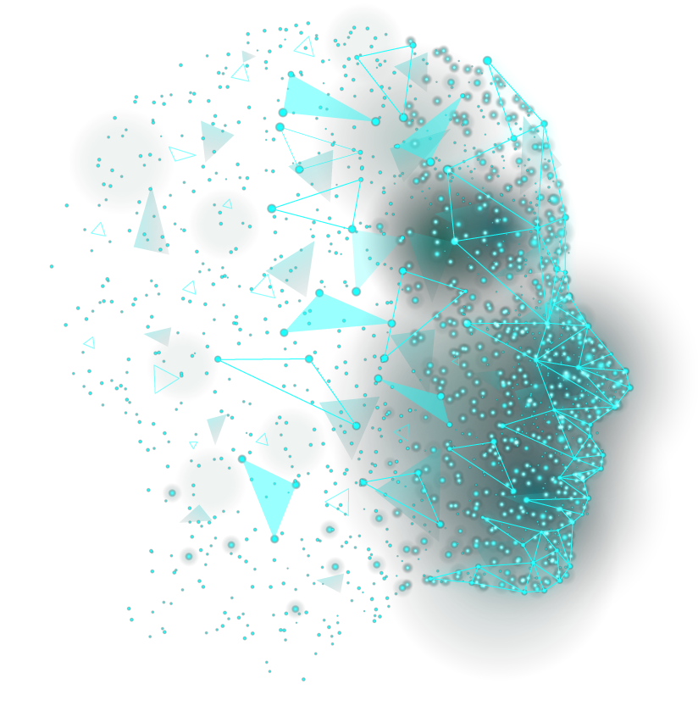
Web-Based Facial Authentication System
Presented By :
Yosri Zayani
Mohammad Hajjaj
Firas Amara
Nada Hermi

Slide 2
TABLE OF CONTENTS
01
04
02
05
03
INTRODUCTION AND MAIN
CONCEPTS EXPLANATION
TOOLS AND DEVELOPMENT PHASES
OVERVIEW OF EXISTING SOLUTIONS
CODE AND EXECUTABLE VERSION
OF OUR SOLUTION
LEVEL DESIGN OF OUR SOLUTION

Slide 3


INTRODUCTION
Facial recognition technology is revolutionizing identity verification across digital platforms.
Web-based facial authentication systems are increasingly popular for applications ranging from securing mobile devices to ensuring the integrity of online exams.
This project explores the core principles, components, and workflows of these systems, as well as privacy considerations and bias mitigation to ensure responsible deployment and use of facial authentication technology.

Slide 4

01
SYSTEM’S MAIN COMPONENTS

Slide 5
MAIN COMPONENTS
IMAGE CAPTURE MODULE
FACIAL DETECTION ALGORITHM
FACEPRINT GENERATION MODULE
Interfaces with the user's device to obtain clear and high-quality facial images. It leverages browser-based technologies to access the device's camera or allows users to upload images from their local storage.
Analyze images to locate and identify human faces.
They employ various techniques to detect facial features such as eyes, nose, and mouth, enabling accurate identification of faces within images.
Extracts distinctive facial features from detected faces and converts them into unique numerical representations.
It analyzes the detected facial landmarks and features to create a digital template that represents the unique characteristics of the user's face.

Slide 6
DATABASE
MATCHING ALGORITHM
USER INTERFACE
Stores pre-registered faceprints of authorized users along with their associated metadata, such as user IDs and registration timestamps. It serves as a repository for user information, facilitating efficient retrieval and comparison of stored faceprints during the authentication process.
Compares the faceprint generated from the captured image with the stored faceprints in the database to determine if a match exists.
It computes similarity scores to authenticate the user, ensuring accurate and reliable identification.
Enables users to interact with the facial authentication system, guiding them through the authentication process and providing real-time feedback. It includes features such as image capture, feedback provision, clear instructions, error handling, and accessibility.

Slide 7

02
EXISTING SOLUTIONS OVERVIEW

Slide 8

Web-based facial authentication systems leverage facial biometrics to enhance digital security and user identification.
This overview examines leading solutions like Amazon Rekognition and Microsoft Azure Face API, and discusses key characteristics and ethical considerations.

Slide 9
CHARACTERISTICS
Accuracy
High precision in identifying individuals.
Security
Enhanced by unique biometric data.
User Experience
Seamless and user-friendly.
Adaptability
Integrates into various web applications.
Scalability
Efficiently handles increased loads.
Real-time Processing
Fast user authentication.

Slide 10
ADVANTAGES
Convenience: No need for passwords; quick verification.
Enhanced Security: Unique facial features reduce unauthorized access risks.
Speed and Efficiency: Fast verification enhances user experience.
Passive Authentication: Operates without disrupting workflows.
Additional Features: Includes functionalities like emotion detection.

Slide 11
LIMITATIONS
Privacy Concerns: Issues with user consent, data minimization, and compliance.
Bias and Fairness: Algorithmic biases can lead to inaccuracies.
Security Vulnerabilities: Risks of data breaches and spoofing.
Liveness Detection Challenges: Ensuring physical presence of users.
Ethical Considerations: Potential misuse in mass surveillance, lack of transparency.

Slide 12
MAIN EXISTING SOLUTIONS
Amazon Rekognition
Characteristics: Facial detection, verification, identification; integrates with AWS.
Advantages: High scalability and reliability; extensive features.
Limitations: Privacy concerns; limited customization.
Microsoft Azure Face API
Characteristics: Facial detection, verification, emotion recognition; integrates with Azure.
Advantages: Advanced machine learning; precise recognition.
Limitations: Potential bias; dependency on Azure.
Google Cloud Vision API
Characteristics: Facial detection, landmark detection, attribute analysis; integrates with Google Cloud.
Advantages: High accuracy; comprehensive analysis.
Limitations: Privacy concerns; higher cost.

Slide 13
OpenCV
Characteristics: Comprehensive set of algorithms; open-source and customizable.
Advantages: Customizable; supported by the community.
Limitations: Steep learning curve; limited advanced features.
Face++
Characteristics: Facial detection, verification, advanced services.
Advantages: High accuracy; trusted by industries.
Limitations: Privacy risks; higher cost.
Trueface
Characteristics: Facial detection, verification, real-time processing.
Advantages: High accuracy; real-time capabilities.
Limitations: Privacy concerns; limited documentation and support.

Slide 14

03
FACIAL AUTHENTICATION SYSTEMS DESIGN AND OPERATIONS

Slide 15
The proposed Web-Based Facial Authentication System aims to provide a robust and secure method for user authentication using facial recognition technology. It ensures a seamless and reliable authentication process for users accessing web-based applications.
DESIGN ELEMENTS:
OPERATIONAL ASPECTS
Structure of the facial authentication system via diagrams, showcasing component interactions for effective user authentication.
Operational insights of the facial authentication system, from enrollment to access management, ensuring seamless and secure functionality.

Slide 16
USERS ROLES
END USERS
SYSTEM ADMINISTRATORS
They interact with the web-based application, undergo facial authentication during login attempts, and access secured features upon successful authentication
Responsible for managing user registrations, maintaining the database, configuring system settings, and overseeing the overall operation of the facial authentication system.

Slide 17
SYSTEM DESIGN
WORKING FLOW
User Enrollment
Authentication Process
Verification and Access
COMPONENTS
User Interface (UI)
Backend Server
Facial Recognition Engine
Database Management System (DBMS)
Web Server
Authentication Logic
AUTHENTICATION RULES
Users must create an account with a username and password.
Secure hashing functions for passwords and facial templates.
Login requires a successful username/password combination followed by facial verification.

Slide 18
USE CASE DIAGRAM

Slide 19
CLASS DIAGRAM

Slide 20
EXCHANGED DATA
Frontend to Backend
Backend to Facial Recognition Engine
Facial Recognition Engine to Backend
Backend to Database
Database to Backend

Slide 21
FACIAL AUTHENTICATION FUNCTIONS AND STEPS
ENROLLMENT FUNCTION
AUTHENTICATION FUNCTION
User uploads facial image.
OpenCV detects faces, extracts features, and generates faceprints.
Faceprints and user data are securely stored in the database.
User initiates authentication and provides username/password.
Facial image captured, processed by OpenCV for face detection and feature extraction.
Faceprint compared with registered ones in the database.
Access granted upon successful verification.

Slide 22
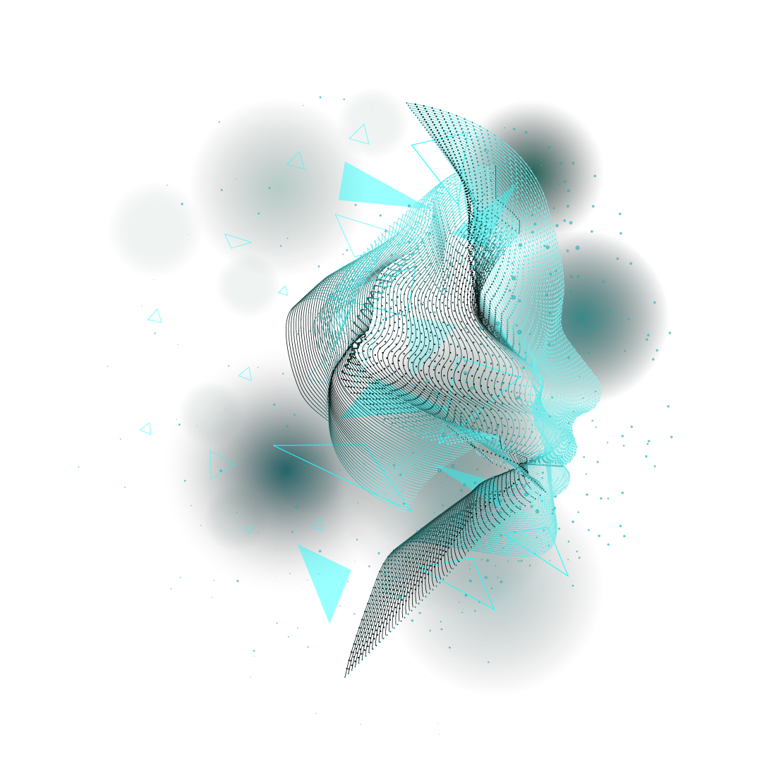
04
TOOLS AND DEVELOPMENT PHASES

Slide 23
PROGRAMMING LANGUAGE
Python: Utilized as the core programming language for system development.
LIBRARIES AND FRAMEWORKS
Tkinter: Provides a user-friendly GUI for seamless user interaction.
OpenCV: Employs advanced image processing and face detection capabilities.
face_recognition: Simplifies facial recognition tasks using pre-trained models.
pyMongo: Facilitates seamless interaction with MongoDB for efficient data storage.

Slide 24
OpenCV Functionality:
Video Capture: Captures video feed from the webcam for face detection.
Face Detection: Utilizes pre-trained models for accurate face detection.
Drawing Bounding Boxes: Visualizes detected faces by drawing bounding boxes.
Recognizing Faces: Compares face encodings for face recognition tasks.

Slide 25
DEVELOPMENT PHASE
Setup Environment
Install Python and required libraries, test webcam functionality.
Face Detection
Capture video feed, implement face detection, draw bounding boxes.
Face Recognition
Preprocess images, train face recognition models, associate names/IDs.
Geometry Analysis
Extract facial landmarks, compute geometric features, create faceprints.
Matching and Authentication
Compare faceprints, implement matching algorithm, set authentication threshold.
Integration and Testing
Integrate components, rigorously test under various conditions.
Deployment and Scaling
Deploy on desired platform, ensure scalability and efficiency.
Documentation and Maintenance
Document project, provide support and maintenance.

Slide 26

CODE
EXECUTABLE VERSION OF THE SOLUTION

Slide 27
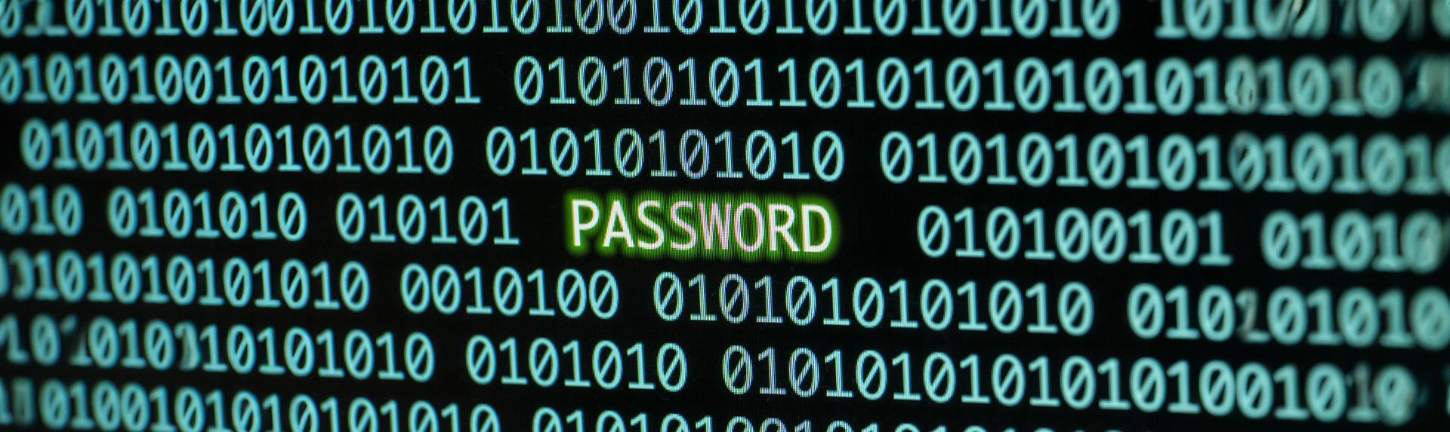

PHOTO SHOWCASE
A photo showcase can be a useful addition to a business project proposal as it can help to visually communicate the concept or idea being proposed

Slide 28
ICON PACK

